Slide 1
Změna životního stylu na pracovišti – příležitost pro zaměstnavatele
Prof. MUDr. Milan Kvapil, CSc., MBA
Geriatrická interní klinika
2. LF UK a FN Motol

Slide 2
Prostředí
Geny
Délka života
Nemoci
Kvalita života
…a trocha štěstí

Slide 9
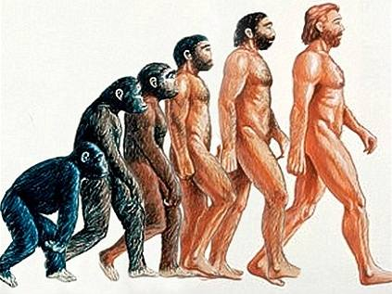

Slide 10
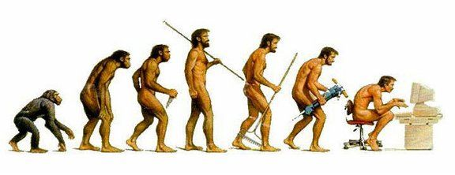
Notes:
Dodělat důsledky civilizační nemoci

Slide 11
ICHS = infarkty, náhlá smrt
CMP = mrtvice, ochrnutí, smrt
Selhání srdce = udušení, smrt
Malignity = smrt
Obezita = dtto + arthrosa
DM2T
HLP
HT
Obezita
Notes:
Dodělat důsledky civilizační nemoci

Slide 12
Prostředí
Pohyb
Strava
Stress
Délka života
Nemoci
Kvalita života

Slide 13
Co nám říká věda?

Slide 14
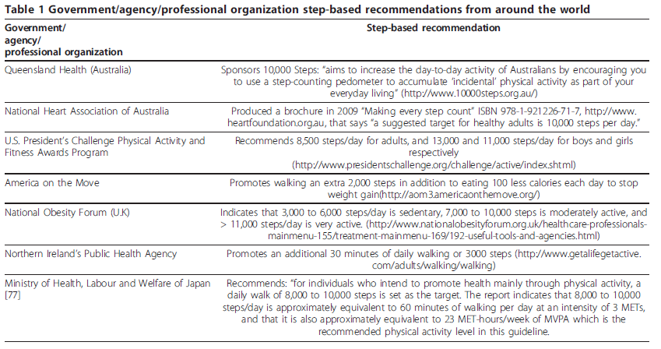
Notes:
Abstract
Physical activity guidelines from around the world are typically expressed in terms of frequency, duration, and
intensity parameters. Objective monitoring using pedometers and accelerometers offers a new opportunity to
measure and communicate physical activity in terms of steps/day. Various step-based versions or translations of
physical activity guidelines are emerging, reflecting public interest in such guidance. However, there appears to be
a wide discrepancy in the exact values that are being communicated. It makes sense that step-based
recommendations should be harmonious with existing evidence-based public health guidelines that recognize that
“some physical activity is better than none” while maintaining a focus on time spent in moderate-to-vigorous
physical activity (MVPA). Thus, the purpose of this review was to update our existing knowledge of “How many
steps/day are enough?”, and to inform step-based recommendations consistent with current physical activity
guidelines. Normative data indicate that healthy adults typically take between 4,000 and 18,000 steps/day, and that
10,000 steps/day is reasonable for this population, although there are notable “low active populations.”
Interventions demonstrate incremental increases on the order of 2,000-2,500 steps/day. The results of seven
different controlled studies demonstrate that there is a strong relationship between cadence and intensity. Further,
despite some inter-individual variation, 100 steps/minute represents a reasonable floor value indicative of moderate
intensity walking. Multiplying this cadence by 30 minutes (i.e., typical of a daily recommendation) produces a
minimum of 3,000 steps that is best used as a heuristic (i.e., guiding) value, but these steps must be taken over and
above habitual activity levels to be a true expression of free-living steps/day that also includes recommendations
for minimal amounts of time in MVPA. Computed steps/day translations of time in MVPA that also include
estimates of habitual activity levels equate to 7,100 to 11,000 steps/day. A direct estimate of minimal amounts of
MVPA accumulated in the course of objectively monitored free-living behaviour is 7,000-8,000 steps/day. A scale
that spans a wide range of incremental increases in steps/day and is congruent with public health recognition that
“some physical activity is better than none,” yet still incorporates step-based translations of recommended amounts
of time in MVPA may be useful in research and practice. The full range of users (researchers to practitioners to the
general public) of objective monitoring instruments that provide step-based outputs require good reference data
and evidence-based recommendations to be able to design effective health messages congruent with public
health physical activity guidelines, guide behaviour change, and ultimately measure, track, and interpret steps/day.

Slide 15
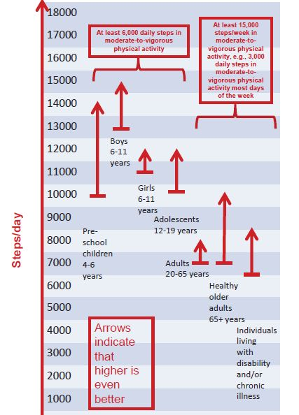
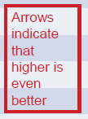
Metaanalýza
1594 citací
837 validních
Notes:
Abstract
Physical activity guidelines from around the world are typically expressed in terms of frequency, duration, and
intensity parameters. Objective monitoring using pedometers and accelerometers offers a new opportunity to
measure and communicate physical activity in terms of steps/day. Various step-based versions or translations of
physical activity guidelines are emerging, reflecting public interest in such guidance. However, there appears to be
a wide discrepancy in the exact values that are being communicated. It makes sense that step-based
recommendations should be harmonious with existing evidence-based public health guidelines that recognize that
“some physical activity is better than none” while maintaining a focus on time spent in moderate-to-vigorous
physical activity (MVPA). Thus, the purpose of this review was to update our existing knowledge of “How many
steps/day are enough?”, and to inform step-based recommendations consistent with current physical activity
guidelines. Normative data indicate that healthy adults typically take between 4,000 and 18,000 steps/day, and that
10,000 steps/day is reasonable for this population, although there are notable “low active populations.”
Interventions demonstrate incremental increases on the order of 2,000-2,500 steps/day. The results of seven
different controlled studies demonstrate that there is a strong relationship between cadence and intensity. Further,
despite some inter-individual variation, 100 steps/minute represents a reasonable floor value indicative of moderate
intensity walking. Multiplying this cadence by 30 minutes (i.e., typical of a daily recommendation) produces a
minimum of 3,000 steps that is best used as a heuristic (i.e., guiding) value, but these steps must be taken over and
above habitual activity levels to be a true expression of free-living steps/day that also includes recommendations
for minimal amounts of time in MVPA. Computed steps/day translations of time in MVPA that also include
estimates of habitual activity levels equate to 7,100 to 11,000 steps/day. A direct estimate of minimal amounts of
MVPA accumulated in the course of objectively monitored free-living behaviour is 7,000-8,000 steps/day. A scale
that spans a wide range of incremental increases in steps/day and is congruent with public health recognition that
“some physical activity is better than none,” yet still incorporates step-based translations of recommended amounts
of time in MVPA may be useful in research and practice. The full range of users (researchers to practitioners to the
general public) of objective monitoring instruments that provide step-based outputs require good reference data
and evidence-based recommendations to be able to design effective health messages congruent with public
health physical activity guidelines, guide behaviour change, and ultimately measure, track, and interpret steps/day.

Slide 16
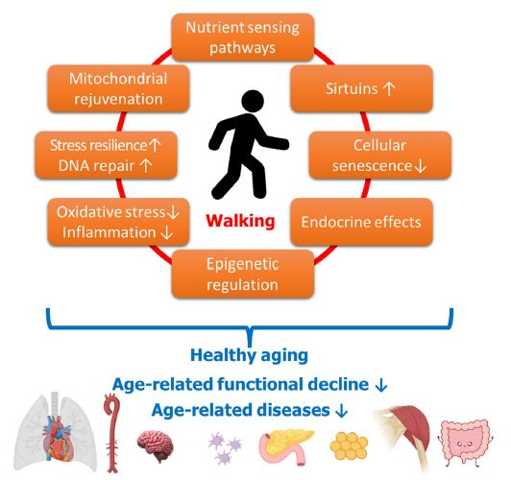
Jak prospívá chůze?
GeroScience (2023) 45:3211–3239
Notes:
Fig. 1 Mechanisms
mediating the anti-aging
health benefits of light
physical exercise and walking.
This figure illustrates
how light physical exercise
and walking contribute to
healthy organismal aging
by potentially reversing
or attenuating underlying
cellular and molecular
mechanisms of aging. By
preventing or delaying agerelated
functional decline
and the onset of age-related
diseases in multiple organ
systems, exercise and
walking promote overall
anti-aging effects
Abstract Physical activity, including walking, has
numerous health benefits in older adults, supported
by a plethora of observational and interventional studies.
Walking decreases the risk or severity of various
health outcomes such as cardiovascular and cerebrovascular
diseases, type 2 diabetes mellitus, cognitive
impairment and dementia, while also improving mental
well-being, sleep, and longevity. Dose-response
relationships for walking duration and intensity are
established for adverse cardiovascular outcomes.
Walking’s favorable effects on cardiovascular risk
factors are attributed to its impact on circulatory, cardiopulmonary,
and immune function. Meeting current
physical activity guidelines by walking briskly for 30
min per day for 5 days can reduce the risk of several
age-associated diseases. Additionally, low-intensity
physical exercise, including walking, exerts anti-aging
effects and helps prevent age-related diseases, making
it a powerful tool for promoting healthy aging. This
is exemplified by the lifestyles of individuals in Blue
Zones, regions of the world with the highest concentration
of centenarians. Walking and other low-intensity
physical activities contribute significantly to the
longevity of individuals in these regions, with walking
being an integral part of their daily lives. Thus, incorporating
walking into daily routines and encouraging
walking-based physical activity interventions can be
an effective strategy for promoting healthy aging and
improving health outcomes in all populations. The
goal of this review is to provide an overview of the
vast and consistent evidence supporting the health
benefits of physical activity, with a specific focus on
walking, and to discuss the impact of walking on various
health outcomes, including the prevention of agerelated
diseases. Furthermore, this review will delve
into the evidence on the impact of walking and lowintensity
physical activity on specific molecular and
cellular mechanisms of aging, providing insights into
the underlying biological mechanisms through which
walking exerts its beneficial anti-aging effects.

Slide 17
Pyramida prevence
STRESS
STRAVA:
1.kvalita
2. kvantita
POHYB

Slide 18
Co nám říká zkušenost?

Slide 19
Změna: nejprve velké nadšení…

Slide 20
…pak velké očekávání…

Slide 21
… a konec jako vždy

Slide 22
Změna životosprávy
Zdravá životospráva jistě prodlouží život a zlepší zdraví
což jistě zlepší výkon v práci
Efekt není buď/anebo; každá změna může mít pozitivní dopad…..pokud nepřekročí práh škodlivosti
Smysl má dlouhodobost (ve 30 letech je to změna na dalších průměrných 50 let)
proto je třeba využít pozitivní motivace a individuálního přístupu

Slide 23
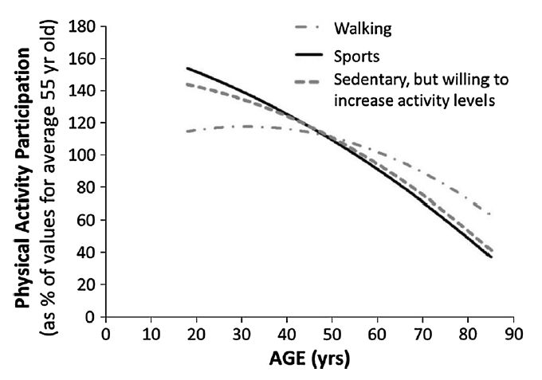
Biogerontology (2016) 17:567–580
Department for Culture MaS (2011) Adult participation in sport: analysis of the taking part survey. https://www.gov.uk/
government/uploads/system/uploads/attachment_data/file/137986/tp-adult-participation-sport-analysis.pdf.
Notes:
Fig. 2 Physical Activity Participation in UK adults. With
increasing age, sports participation progressively declines.
Walking for health benefits or enjoyment remains fairly constant
amongst young and middle-aged adults, but declines progressively
into older age. Amongst those who are sedentary, more of
the younger adults have a desire to increase physical activity
levels compared with the middle-aged and the old. Data are from
The Taking Part Survey, which interviewed[92,000 people in
England between 2005 and 2009 to ask about physical activity
habits (Department for Culture 2011)

Slide 24
Změna životosprávy
Zdravá životospráva jistě prodlouží život a zlepší zdraví
což jistě zlepší výkon v práci
Efekt není buď/anebo; každá změna může mít pozitivní dopad…..pokud nepřekročí práh škodlivosti
Smysl má dlouhodobost (ve 30 letech je to změna na dalších průměrných 50 let)
proto je třeba využít pozitivní motivace a individuálního přístupu

Slide 25
Z mého života….

Slide 26
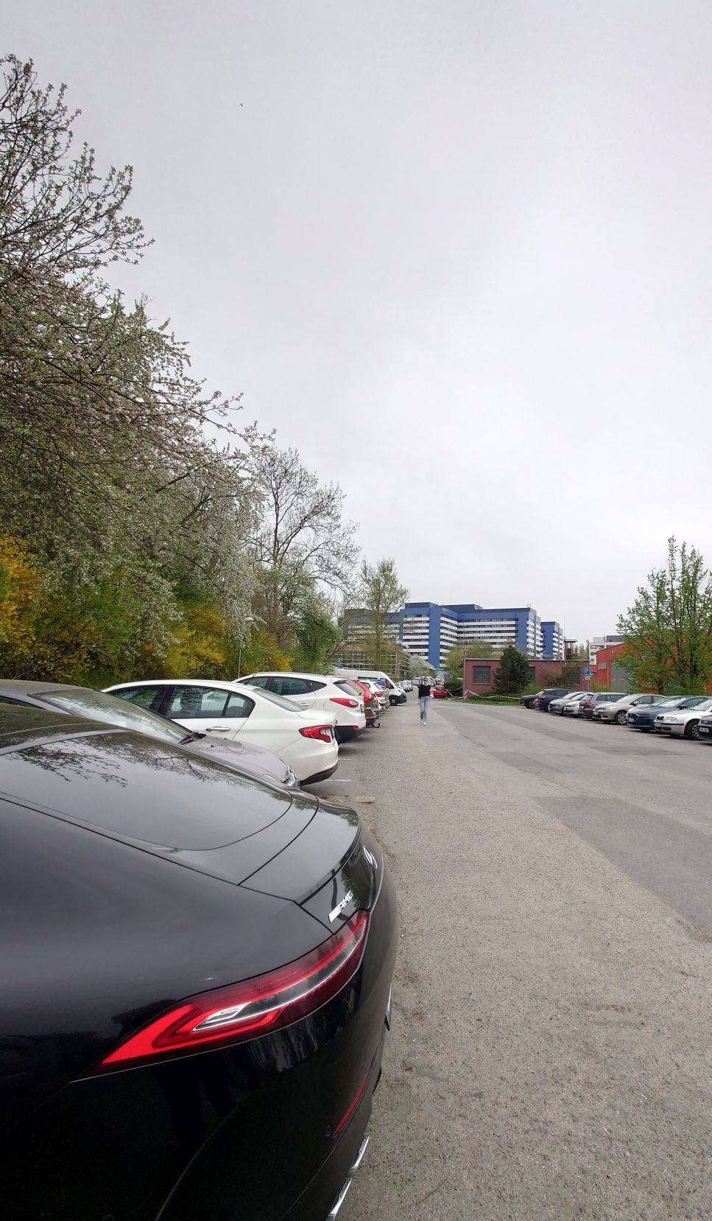
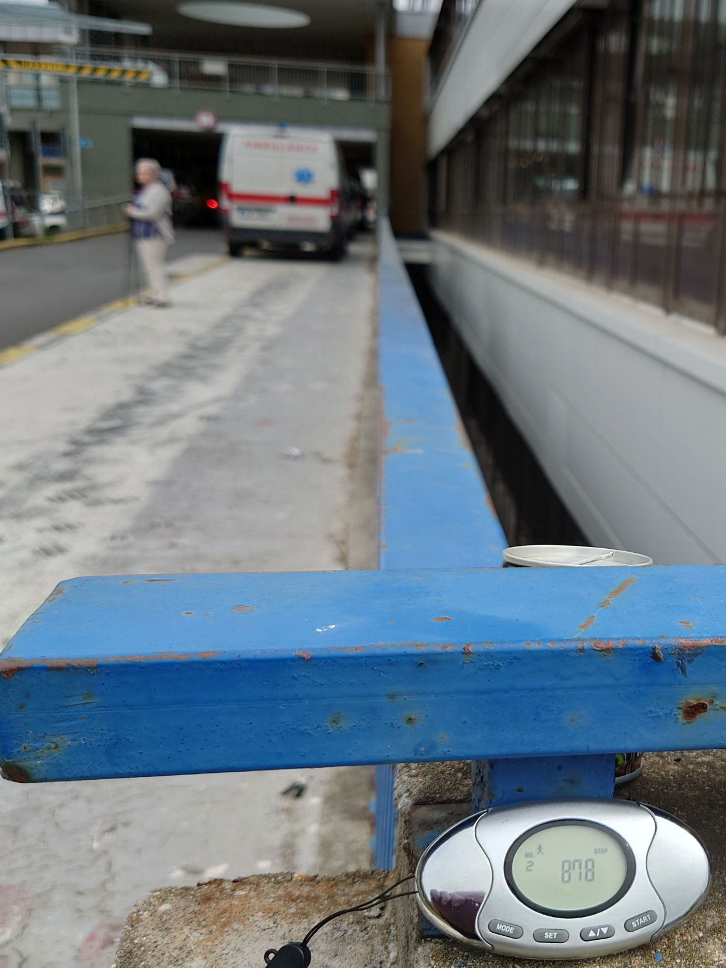
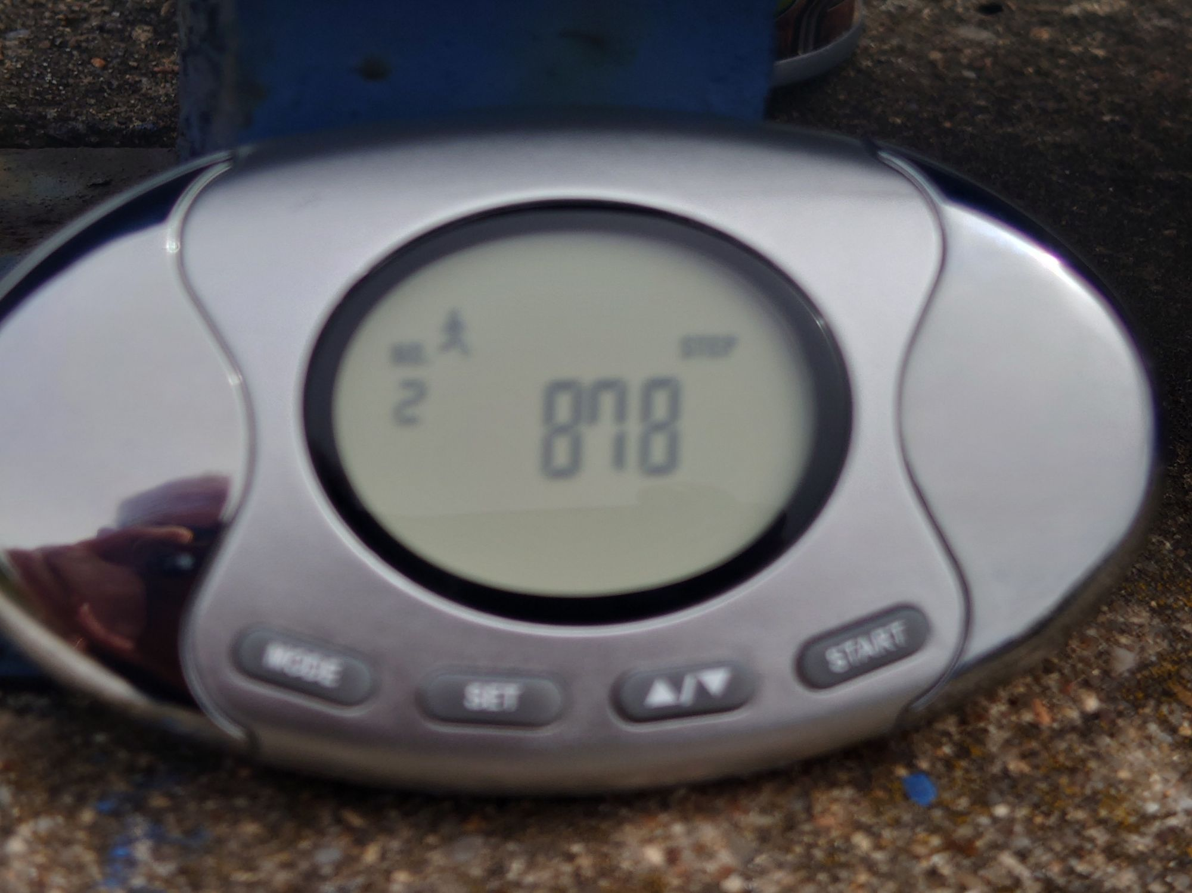
1999 - 2020 jsem byl přednostou Interní kliniky 2. LF UK a FN Motol

Slide 27
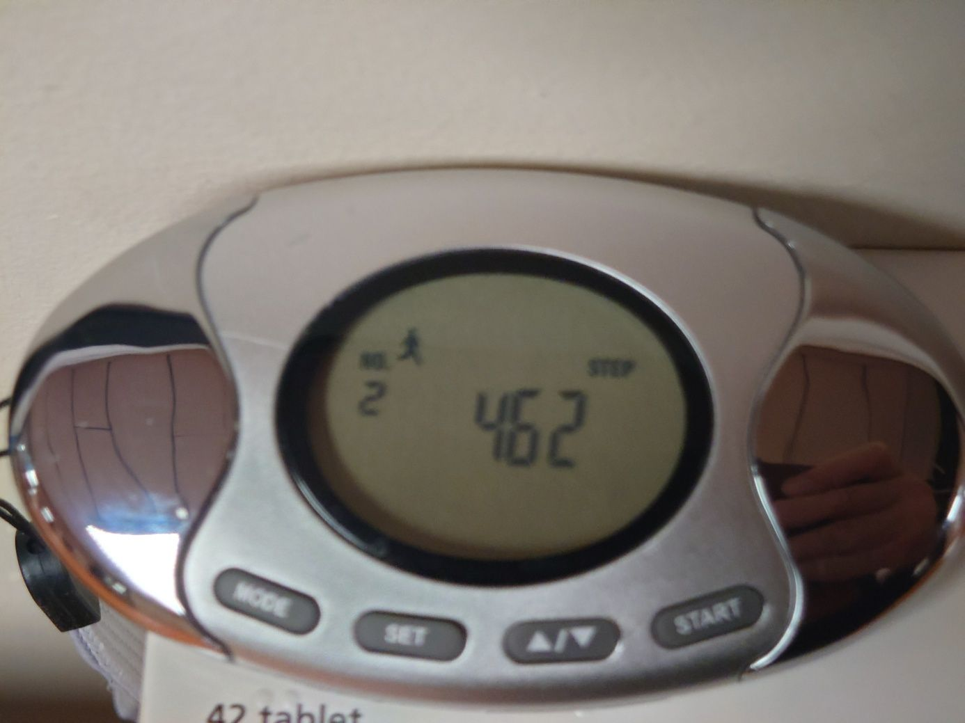
..z jednoho konce kliniky na druhý…
..5 -7x denně = 7 – 10 tis. kroků

Slide 28
Od r. 2021 jsem přednostou Geriatrické interní kliniky 2. LF UK a FN Motol

Slide 29
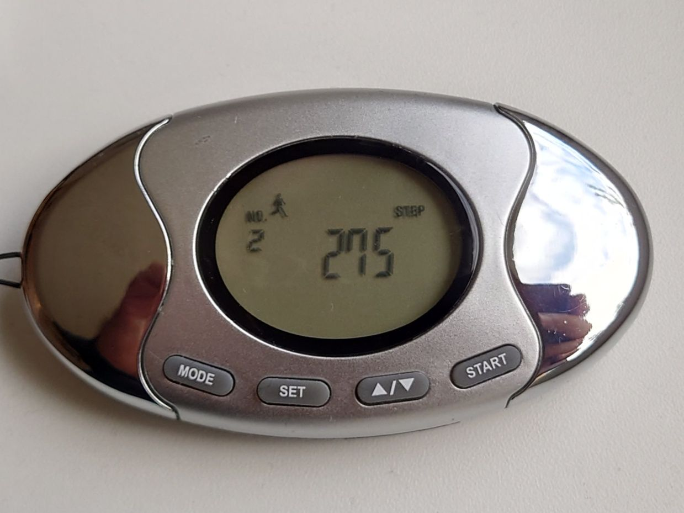
Od r. 2021 jsem přednostou Geriatrické interní kliniky 2. LF UK a FN Motol
Výsledkem je, že denně ujdu v práci <1000 kroků

Slide 30
Děkujeme za pozornost
geriatrie@fnmotol.cz

Slide 31
DM2T
HLP
HT
Notes:
Dodělat důsledky civilizační nemoci

Slide 32
Pole neorané….
BMC Health Services Research (2025) 25:133

Slide 33
Prostředí
Pohyb
Strava
Stress
Délka života
Nemoci
Kvalit života

